Slide 1
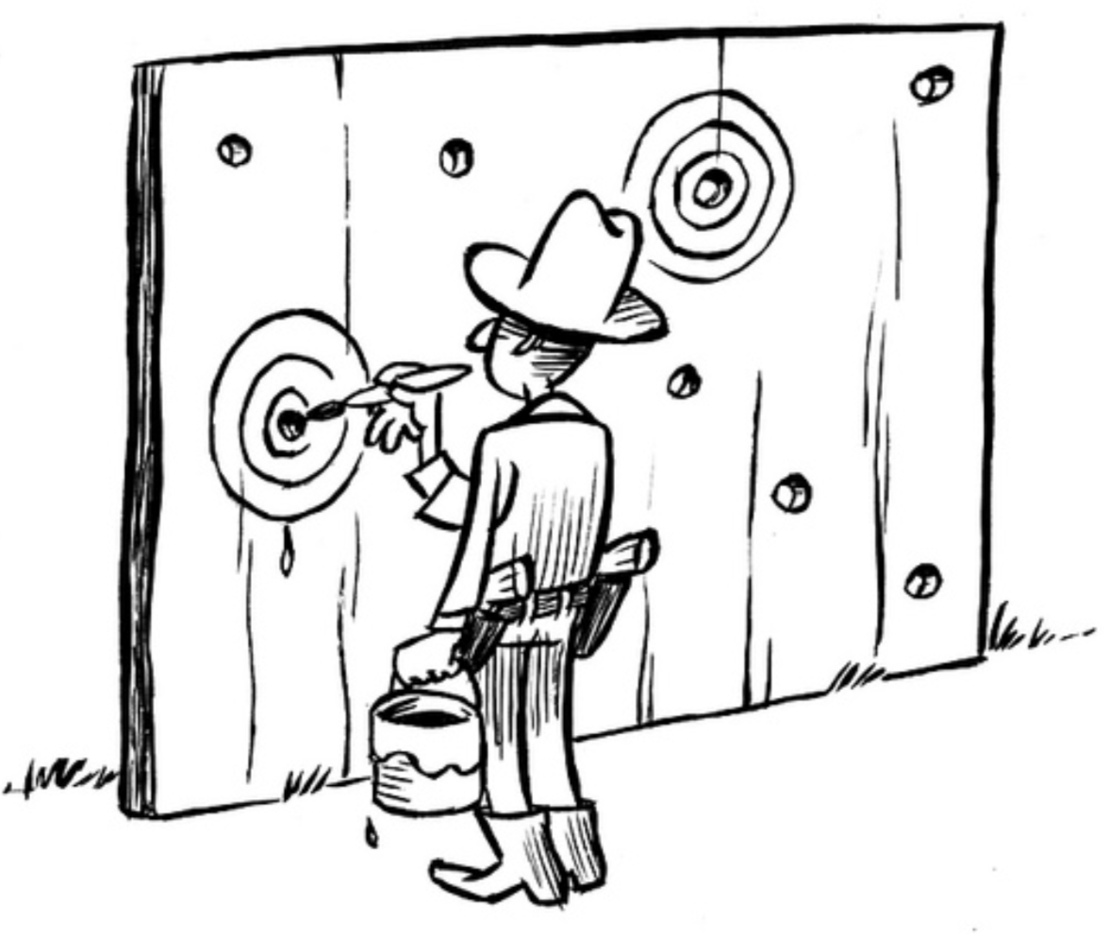
Post-hoc theory
All non-significant (p > 0.05) results you already played are now worth two points.
Post-hoc theory

Slide 2
Post-hoc theory
All non-significant (p > 0.05) results you already played are now worth two points.
Post-hoc theory

Slide 3
Post-hoc theory
All non-significant (p > 0.05) results you already played are now worth two points.
Post-hoc theory

Slide 4
Post-hoc theory
All non-significant (p > 0.05) results you already played are now worth two points.
Post-hoc theory

Slide 5


Behind the Pay-wall
Turn the (1) test and (2) statistic cards of one of your played significance tests facedown. Significance tests with facedown cards cannot be Statchecked.
Behind the Pay-wall

Slide 6
Behind the Pay-wall
Turn the (1) test and (2) statistic cards of one of your played significance tests facedown. Significance tests with facedown cards cannot be Statchecked.
Behind the Pay-wall

Slide 7
Behind the Pay-wall
Turn the (1) test and (2) statistic cards of one of your played significance tests facedown. Significance tests with facedown cards cannot be Statchecked.
Behind the Pay-wall

Slide 8
Behind the Pay-wall
Turn the (1) test and (2) statistic cards of one of your played significance tests facedown. Significance tests with facedown cards cannot be Statchecked.
Behind the Pay-wall

Slide 9
Behind the Pay-wall
Turn the (1) test and (2) statistic cards of one of your played significance tests facedown. Significance tests with facedown cards cannot be Statchecked.
Behind the Pay-wall

Slide 10

Statcheck!
Run a played significance test through statcheck. If the result is inconsistent, discard the significance test.
Statcheck!

Slide 11
Statcheck!
Run a played significance test through statcheck. If the result is inconsistent, discard the significance test.
Statcheck!

Slide 12
Statcheck!
Run a played significance test through statcheck. If the result is inconsistent, discard the significance test.
Statcheck!

Slide 13
Statcheck!
Run a played significance test through statcheck. If the result is inconsistent, discard the significance test.
Statcheck!

Slide 14
Statcheck!
Run a played significance test through statcheck. If the result is inconsistent, discard the significance test.
Statcheck!

Slide 15
Statcheck!
Run a played significance test through statcheck. If the result is inconsistent, discard the significance test.
Statcheck!

Slide 16
Statcheck!
Run a played significance test through statcheck. If the result is inconsistent, discard the significance test.
Statcheck!

Slide 17
Statcheck!
Run a played significance test through statcheck. If the result is inconsistent, discard the significance test.
Statcheck!

Slide 18
Statcheck!
Run a played significance test through statcheck. If the result is inconsistent, discard the significance test.
Statcheck!

Slide 19
Statcheck!
Run a played significance test through statcheck. If the result is inconsistent, discard the significance test.
Statcheck!

Slide 20
Statcheck!
Run a played significance test through statcheck. If the result is inconsistent, discard the significance test.
Statcheck!

Slide 21
Statcheck!
Run a played significance test through statcheck. If the result is inconsistent, discard the significance test.
Statcheck!

Slide 22
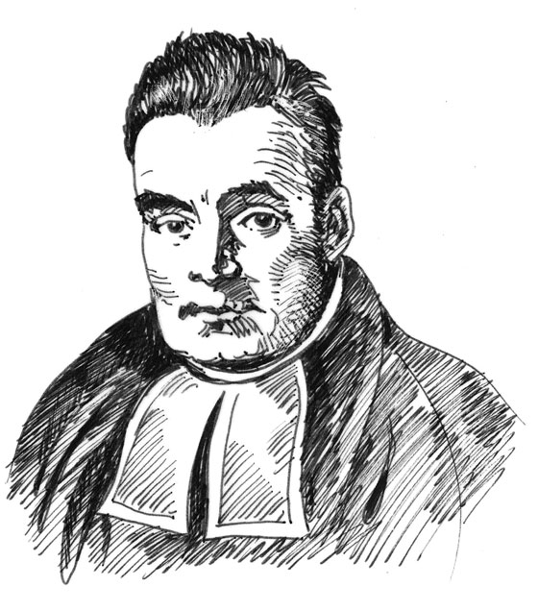
Bayes Factor
Play on a significance test on the board. If (3) p-value is non-significant (p > 0.05), it is now worth 2 points. If (3) p-value is significant (p < 0.05), it is now worth only 1 point.
Bayes Factor

Slide 23
Bayes Factor
Play on a significance test on the board. If (3) p-value is non-significant (p > 0.05), it is now worth 2 points. If (3) p-value is significant (p < 0.05), it is now worth only 1 point.
Bayes Factor

Slide 24
Bayes Factor
Play on a significance test on the board. If (3) p-value is non-significant (p > 0.05), it is now worth 2 points. If (3) p-value is significant (p < 0.05), it is now worth only 1 point.
Bayes Factor

Slide 25
Bayes Factor
Play on a significance test on the board. If (3) p-value is non-significant (p > 0.05), it is now worth 2 points. If (3) p-value is significant (p < 0.05), it is now worth only 1 point.
Bayes Factor

Slide 26
Bayes Factor
Play on a significance test on the board. If (3) p-value is non-significant (p > 0.05), it is now worth 2 points. If (3) p-value is significant (p < 0.05), it is now worth only 1 point.
Bayes Factor

Slide 27
Bayes Factor
Play on a significance test on the board. If (3) p-value is non-significant (p > 0.05), it is now worth 2 points. If (3) p-value is significant (p < 0.05), it is now worth only 1 point.
Bayes Factor

Slide 28

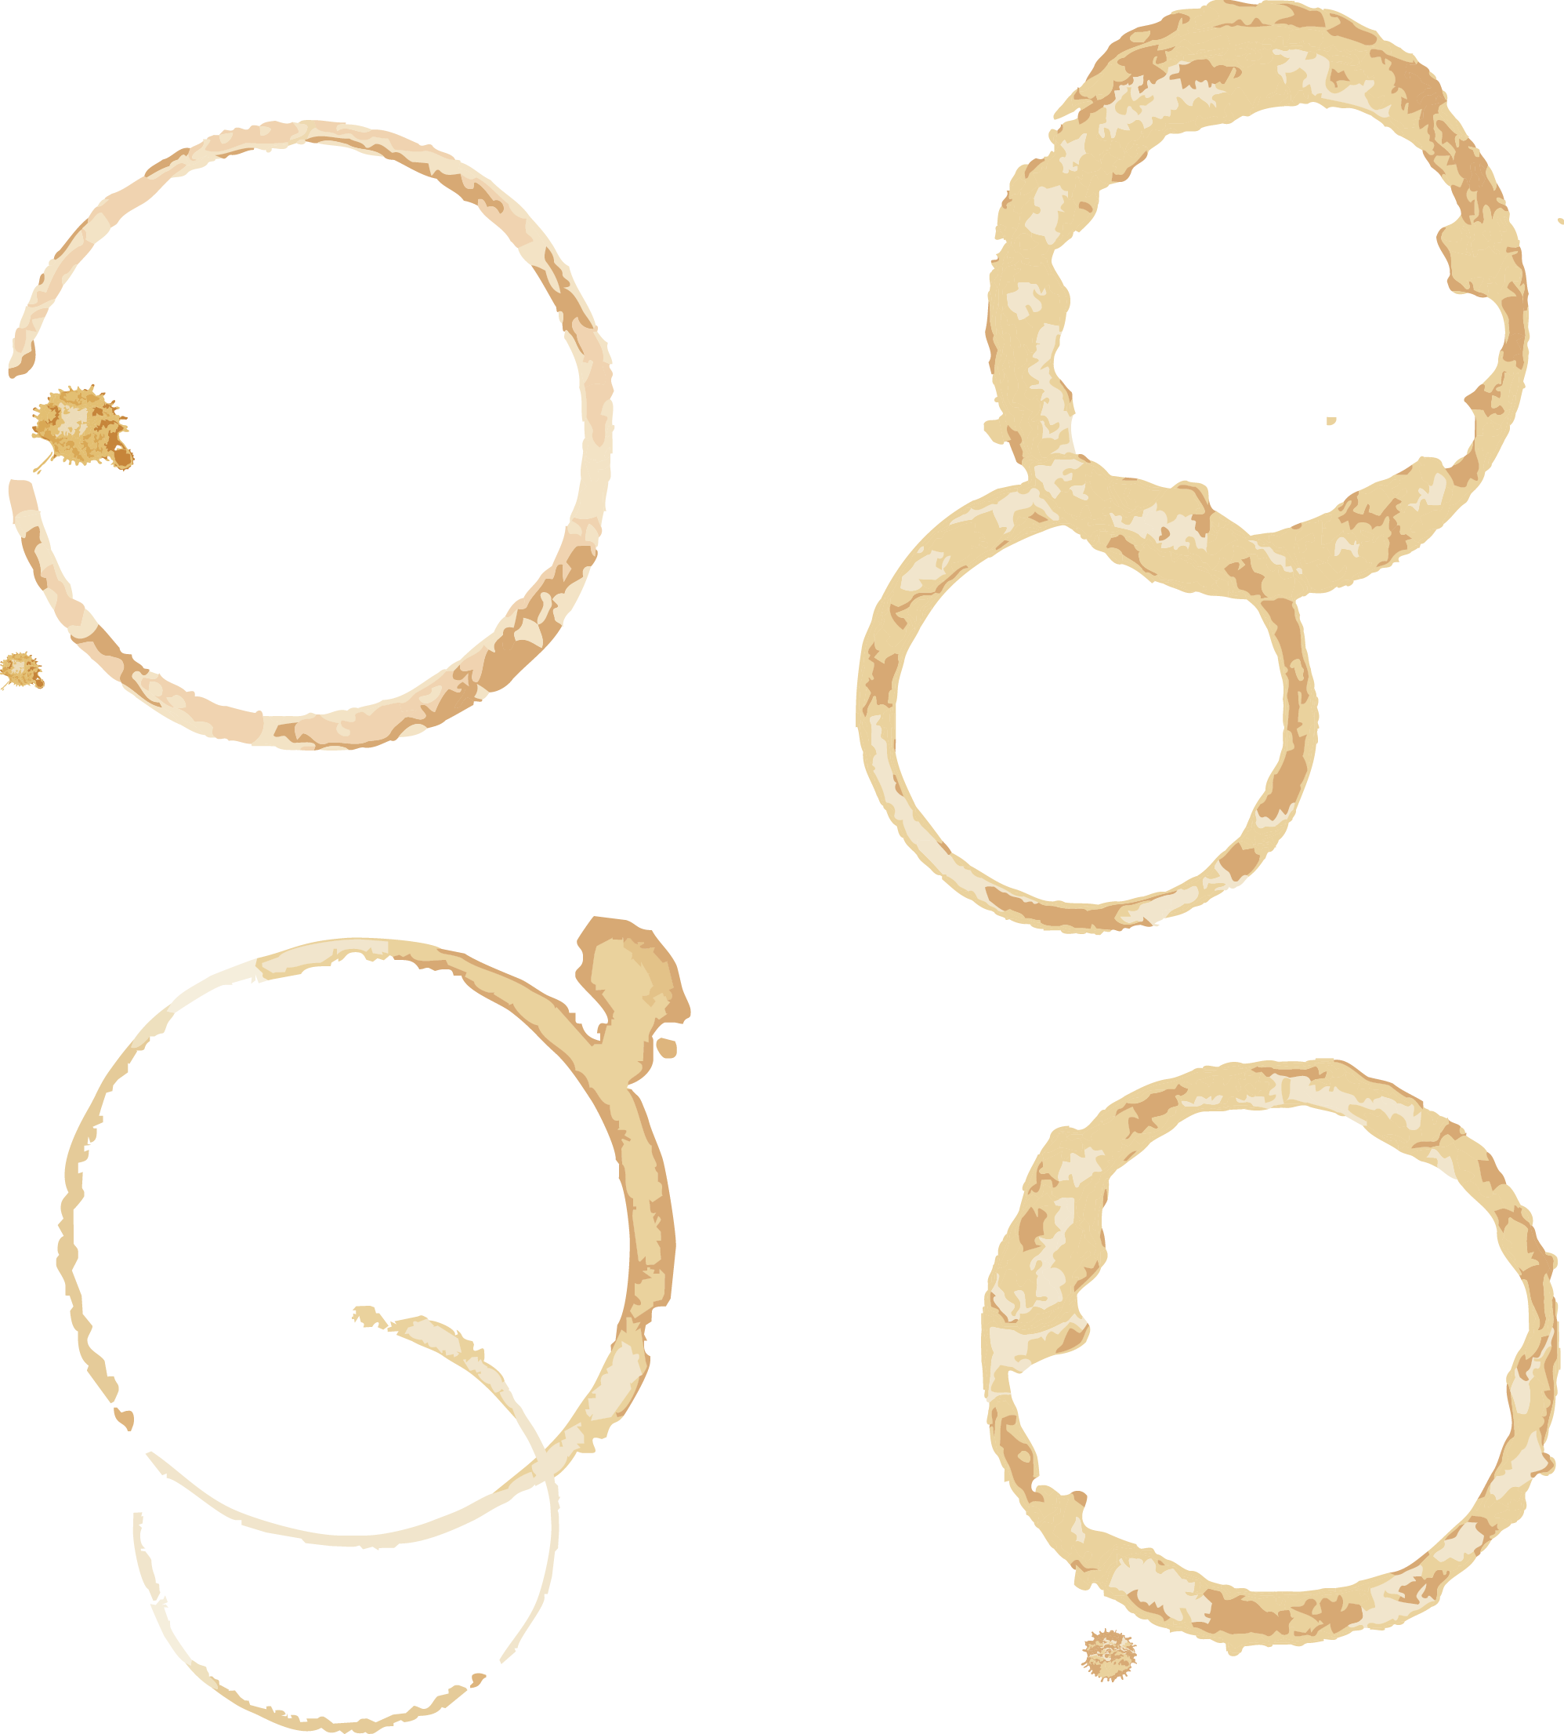
60-hour work week
You can play any number of significance tests this turn.
Choose one: draw 2 cards, or draw 3 cards and skip your next turn.
60-hour work week

Slide 29
60-hour work week
You can play any number of significance tests this turn.
Choose one: draw 2 cards, or draw 3 cards and skip your next turn.
60-hour work week

Slide 30
60-hour work week
You can play any number of significance tests this turn.
Choose one: draw 2 cards, or draw 3 cards and skip your next turn.
60-hour work week

Slide 31
60-hour work week
You can play any number of significance tests this turn.
Choose one: draw 2 cards, or draw 3 cards and skip your next turn.
60-hour work week

Slide 32
60-hour work week
You can play any number of significance tests this turn.
Choose one: draw 2 cards, or draw 3 cards and skip your next turn.
60-hour work week

Slide 33
60-hour work week
You can play any number of significance tests this turn.
Choose one: draw 2 cards, or draw 3 cards and skip your next turn.
60-hour work week

Slide 34
60-hour work week
You can play any number of significance tests this turn.
Choose one: draw 2 cards, or draw 3 cards and skip your next turn.
60-hour work week

Slide 35
60-hour work week
You can play any number of significance tests this turn.
Choose one: draw 2 cards, or draw 3 cards and skip your next turn.
60-hour work week

Slide 36
60-hour work week
You can play any number of significance tests this turn.
Choose one: draw 2 cards, or draw 3 cards and skip your next turn.
60-hour work week

Slide 37
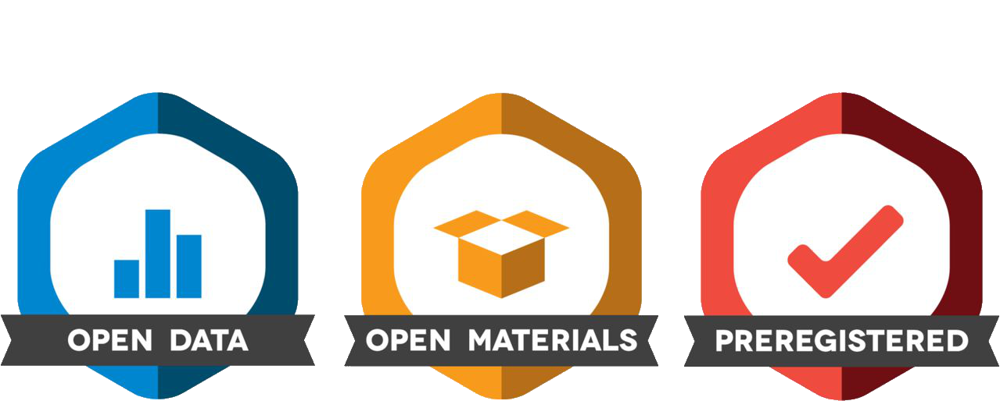
Open Science
Choose a player. That player reveals his or her hand and turns all face-down cards on the table face-up.
Open Science

Slide 38
Open Science
Choose a player. That player reveals his or her hand and turns all face-down cards on the table face-up.
Open Science

Slide 39
Open Science
Choose a player. That player reveals his or her hand and turns all face-down cards on the table face-up.
Open Science

Slide 40
Open Science
Choose a player. That player reveals his or her hand and turns all face-down cards on the table face-up.
Open Science

Slide 41
Open Science
Choose a player. That player reveals his or her hand and turns all face-down cards on the table face-up.
Open Science

Slide 42
Open Science
Choose a player. That player reveals his or her hand and turns all face-down cards on the table face-up.
Open Science

Slide 43

Fraudster
Play this card to draw one card OR play this card to re-roll your publication roll. If revealed by the open-science card: discard your hand and all your played significance tests.
Fraudster

Slide 44
Fraudster
Play this card to draw one card OR play this card to re-roll your publication roll. If revealed by the open-science card: discard your hand and all your played significance tests.
Fraudster

Slide 45
Fraudster
Play this card to draw one card OR play this card to re-roll your publication roll. If revealed by the open-science card: discard your hand and all your played significance tests.
Fraudster

Slide 46
(1) Test
F(7,86)
Can only be played in combination with (2) statistic and (3) p-value. Place all three cards on the table when playing a significance test.
(1) Test

Slide 47
(1) Test
F(6,169)
Can only be played in combination with (2) statistic and (3) p-value. Place all three cards on the table when playing a significance test.
(1) Test

Slide 48
(1) Test
F(15,20)
Can only be played in combination with (2) statistic and (3) p-value. Place all three cards on the table when playing a significance test.
(1) Test

Slide 49
(1) Test
F(13,42)
Can only be played in combination with (2) statistic and (3) p-value. Place all three cards on the table when playing a significance test.
(1) Test

Slide 50
(1) Test
F(8,148)
Can only be played in combination with (2) statistic and (3) p-value. Place all three cards on the table when playing a significance test.
(1) Test

Slide 51
(1) Test
F(13,68)
Can only be played in combination with (2) statistic and (3) p-value. Place all three cards on the table when playing a significance test.
(1) Test

Slide 52
(1) Test
F(10,108)
Can only be played in combination with (2) statistic and (3) p-value. Place all three cards on the table when playing a significance test.
(1) Test

Slide 53
(1) Test
F(9,95)
Can only be played in combination with (2) statistic and (3) p-value. Place all three cards on the table when playing a significance test.
(1) Test

Slide 54
(1) Test
F(8,174)
Can only be played in combination with (2) statistic and (3) p-value. Place all three cards on the table when playing a significance test.
(1) Test

Slide 55
(1) Test
F(9,46)
Can only be played in combination with (2) statistic and (3) p-value. Place all three cards on the table when playing a significance test.
(1) Test

Slide 56
(1) Test
F(11,40)
Can only be played in combination with (2) statistic and (3) p-value. Place all three cards on the table when playing a significance test.
(1) Test

Slide 57
(1) Test
F(11,97)
Can only be played in combination with (2) statistic and (3) p-value. Place all three cards on the table when playing a significance test.
(1) Test

Slide 58
(1) Test
F(8,85)
Can only be played in combination with (2) statistic and (3) p-value. Place all three cards on the table when playing a significance test.
(1) Test

Slide 59
(1) Test
F(8,79)
Can only be played in combination with (2) statistic and (3) p-value. Place all three cards on the table when playing a significance test.
(1) Test

Slide 60
(1) Test
F(9,168)
Can only be played in combination with (2) statistic and (3) p-value. Place all three cards on the table when playing a significance test.
(1) Test

Slide 61
(1) Test
F(11,118)
Can only be played in combination with (2) statistic and (3) p-value. Place all three cards on the table when playing a significance test.
(1) Test

Slide 62
(1) Test
F(14,39)
Can only be played in combination with (2) statistic and (3) p-value. Place all three cards on the table when playing a significance test.
(1) Test

Slide 63
(1) Test
F(10,154)
Can only be played in combination with (2) statistic and (3) p-value. Place all three cards on the table when playing a significance test.
(1) Test

Slide 64
(1) Test
F(17,43)
Can only be played in combination with (2) statistic and (3) p-value. Place all three cards on the table when playing a significance test.
(1) Test

Slide 65
(1) Test
F(7,198)
Can only be played in combination with (2) statistic and (3) p-value. Place all three cards on the table when playing a significance test.
(1) Test

Slide 66
(1) Test
F(7,145)
Can only be played in combination with (2) statistic and (3) p-value. Place all three cards on the table when playing a significance test.
(1) Test

Slide 67
(1) Test
F(9,54)
Can only be played in combination with (2) statistic and (3) p-value. Place all three cards on the table when playing a significance test.
(1) Test

Slide 68
(1) Test
F(6,96)
Can only be played in combination with (2) statistic and (3) p-value. Place all three cards on the table when playing a significance test.
(1) Test

Slide 69
(1) Test
F(16,32)
Can only be played in combination with (2) statistic and (3) p-value. Place all three cards on the table when playing a significance test.
(1) Test

Slide 70
(1) Test
F(13,66)
Can only be played in combination with (2) statistic and (3) p-value. Place all three cards on the table when playing a significance test.
(1) Test

Slide 71
(1) Test
F(13,41)
Can only be played in combination with (2) statistic and (3) p-value. Place all three cards on the table when playing a significance test.
(1) Test

Slide 72
(1) Test
F(10,126)
Can only be played in combination with (2) statistic and (3) p-value. Place all three cards on the table when playing a significance test.
(1) Test

Slide 73
(1) Test
F(8,151)
Can only be played in combination with (2) statistic and (3) p-value. Place all three cards on the table when playing a significance test.
(1) Test

Slide 74
(1) Test
F(8,91)
Can only be played in combination with (2) statistic and (3) p-value. Place all three cards on the table when playing a significance test.
(1) Test

Slide 75
(1) Test
F(10,176)
Can only be played in combination with (2) statistic and (3) p-value. Place all three cards on the table when playing a significance test.
(1) Test

Slide 76
(2) Statistic
= 1.7,
Can only be played in combination with (1) test and (3) p-value. Place all three cards on the table when playing a significance test.
(2) Statistic

Slide 77
(2) Statistic
= 1.7,
Can only be played in combination with (1) test and (3) p-value. Place all three cards on the table when playing a significance test.
(2) Statistic

Slide 78
(2) Statistic
= 1.8,
Can only be played in combination with (1) test and (3) p-value. Place all three cards on the table when playing a significance test.
(2) Statistic

Slide 79
(2) Statistic
= 1.8,
Can only be played in combination with (1) test and (3) p-value. Place all three cards on the table when playing a significance test.
(2) Statistic

Slide 80
(2) Statistic
= 1.8,
Can only be played in combination with (1) test and (3) p-value. Place all three cards on the table when playing a significance test.
(2) Statistic

Slide 81
(2) Statistic
= 1.8,
Can only be played in combination with (1) test and (3) p-value. Place all three cards on the table when playing a significance test.
(2) Statistic

Slide 82
(2) Statistic
= 1.9,
Can only be played in combination with (1) test and (3) p-value. Place all three cards on the table when playing a significance test.
(2) Statistic

Slide 83
(2) Statistic
= 1.9,
Can only be played in combination with (1) test and (3) p-value. Place all three cards on the table when playing a significance test.
(2) Statistic

Slide 84
(2) Statistic
= 1.9,
Can only be played in combination with (1) test and (3) p-value. Place all three cards on the table when playing a significance test.
(2) Statistic

Slide 85
(2) Statistic
= 1.9,
Can only be played in combination with (1) test and (3) p-value. Place all three cards on the table when playing a significance test.
(2) Statistic

Slide 86
(2) Statistic
= 1.9,
Can only be played in combination with (1) test and (3) p-value. Place all three cards on the table when playing a significance test.
(2) Statistic

Slide 87
(2) Statistic
= 2.0,
Can only be played in combination with (1) test and (3) p-value. Place all three cards on the table when playing a significance test.
(2) Statistic

Slide 88
(2) Statistic
= 2.0,
Can only be played in combination with (1) test and (3) p-value. Place all three cards on the table when playing a significance test.
(2) Statistic

Slide 89
(2) Statistic
= 2.1,
Can only be played in combination with (1) test and (3) p-value. Place all three cards on the table when playing a significance test.
(2) Statistic

Slide 90
(2) Statistic
= 2.1,
Can only be played in combination with (1) test and (3) p-value. Place all three cards on the table when playing a significance test.
(2) Statistic

Slide 91
(2) Statistic
= 2.1,
Can only be played in combination with (1) test and (3) p-value. Place all three cards on the table when playing a significance test.
(2) Statistic

Slide 92
(2) Statistic
= 2.2,
Can only be played in combination with (1) test and (3) p-value. Place all three cards on the table when playing a significance test.
(2) Statistic

Slide 93
(2) Statistic
= 2.2,
Can only be played in combination with (1) test and (3) p-value. Place all three cards on the table when playing a significance test.
(2) Statistic

Slide 94
(2) Statistic
= 2.2,
Can only be played in combination with (1) test and (3) p-value. Place all three cards on the table when playing a significance test.
(2) Statistic

Slide 95
(2) Statistic
= 2.2,
Can only be played in combination with (1) test and (3) p-value. Place all three cards on the table when playing a significance test.
(2) Statistic

Slide 96
(2) Statistic
= 2.3,
Can only be played in combination with (1) test and (3) p-value. Place all three cards on the table when playing a significance test.
(2) Statistic

Slide 97
(2) Statistic
= 2.3,
Can only be played in combination with (1) test and (3) p-value. Place all three cards on the table when playing a significance test.
(2) Statistic

Slide 98
(2) Statistic
= 2.3,
Can only be played in combination with (1) test and (3) p-value. Place all three cards on the table when playing a significance test.
(2) Statistic

Slide 99
(2) Statistic
= 2.3,
Can only be played in combination with (1) test and (3) p-value. Place all three cards on the table when playing a significance test.
(2) Statistic

Slide 100
(2) Statistic
= 2.3,
Can only be played in combination with (1) test and (3) p-value. Place all three cards on the table when playing a significance test.
(2) Statistic

Slide 101
(2) Statistic
= 2.3,
Can only be played in combination with (1) test and (3) p-value. Place all three cards on the table when playing a significance test.
(2) Statistic

Slide 102
(2) Statistic
= 2.4,
Can only be played in combination with (1) test and (3) p-value. Place all three cards on the table when playing a significance test.
(2) Statistic

Slide 103
(2) Statistic
= 2.4,
Can only be played in combination with (1) test and (3) p-value. Place all three cards on the table when playing a significance test.
(2) Statistic

Slide 104
(2) Statistic
= 2.4,
Can only be played in combination with (1) test and (3) p-value. Place all three cards on the table when playing a significance test.
(2) Statistic

Slide 105
(2) Statistic
= 2.4,
Can only be played in combination with (1) test and (3) p-value. Place all three cards on the table when playing a significance test.
(2) Statistic

Slide 106

(3) p-value
P < 0.05
2 Points!
Can only be played in combination with (1) test and (2) statistic. Place all three cards on the table when playing a significance test.
(3) p-value

Slide 107
(3) p-value
P < 0.05
2 Points!
Can only be played in combination with (1) test and (2) statistic. Place all three cards on the table when playing a significance test.
(3) p-value

Slide 108
(3) p-value
P < 0.05
2 Points!
Can only be played in combination with (1) test and (2) statistic. Place all three cards on the table when playing a significance test.
(3) p-value

Slide 109
(3) p-value
P < 0.05
2 Points!
Can only be played in combination with (1) test and (2) statistic. Place all three cards on the table when playing a significance test.
(3) p-value

Slide 110
(3) p-value
P < 0.05
2 Points!
Can only be played in combination with (1) test and (2) statistic. Place all three cards on the table when playing a significance test.
(3) p-value

Slide 111
(3) p-value
P < 0.05
2 Points!
Can only be played in combination with (1) test and (2) statistic. Place all three cards on the table when playing a significance test.
(3) p-value

Slide 112
(3) p-value
P < 0.05
2 Points!
Can only be played in combination with (1) test and (2) statistic. Place all three cards on the table when playing a significance test.
(3) p-value

Slide 113
(3) p-value
P < 0.05
2 Points!
Can only be played in combination with (1) test and (2) statistic. Place all three cards on the table when playing a significance test.
(3) p-value

Slide 114
(3) p-value
P < 0.05
2 Points!
Can only be played in combination with (1) test and (2) statistic. Place all three cards on the table when playing a significance test.
(3) p-value

Slide 115
(3) p-value
P < 0.05
2 Points!
Can only be played in combination with (1) test and (2) statistic. Place all three cards on the table when playing a significance test.
(3) p-value

Slide 116
(3) p-value
P < 0.05
2 Points!
Can only be played in combination with (1) test and (2) statistic. Place all three cards on the table when playing a significance test.
(3) p-value

Slide 117
(3) p-value
P < 0.05
2 Points!
Can only be played in combination with (1) test and (2) statistic. Place all three cards on the table when playing a significance test.
(3) p-value

Slide 118
(3) p-value
P < 0.05
2 Points!
Can only be played in combination with (1) test and (2) statistic. Place all three cards on the table when playing a significance test.
(3) p-value

Slide 119
(3) p-value
P < 0.05
2 Points!
Can only be played in combination with (1) test and (2) statistic. Place all three cards on the table when playing a significance test.
(3) p-value

Slide 120
(3) p-value
P < 0.05
2 Points!
Can only be played in combination with (1) test and (2) statistic. Place all three cards on the table when playing a significance test.
(3) p-value

Slide 121
(3) p-value
P > 0.05
1 Point!
Can only be played in combination with (1) test and (2) statistic. Place all three cards on the table when playing a significance test.
(3) p-value

Slide 122
(3) p-value
P > 0.05
1 Point!
Can only be played in combination with (1) test and (2) statistic. Place all three cards on the table when playing a significance test.
(3) p-value

Slide 123
(3) p-value
P > 0.05
1 Point!
Can only be played in combination with (1) test and (2) statistic. Place all three cards on the table when playing a significance test.
(3) p-value

Slide 124
(3) p-value
P > 0.05
1 Point!
Can only be played in combination with (1) test and (2) statistic. Place all three cards on the table when playing a significance test.
(3) p-value

Slide 125
(3) p-value
P > 0.05
1 Point!
Can only be played in combination with (1) test and (2) statistic. Place all three cards on the table when playing a significance test.
(3) p-value

Slide 126
(3) p-value
P > 0.05
1 Point!
Can only be played in combination with (1) test and (2) statistic. Place all three cards on the table when playing a significance test.
(3) p-value

Slide 127
(3) p-value
P > 0.05
1 Point!
Can only be played in combination with (1) test and (2) statistic. Place all three cards on the table when playing a significance test.
(3) p-value

Slide 128
(3) p-value
P > 0.05
1 Point!
Can only be played in combination with (1) test and (2) statistic. Place all three cards on the table when playing a significance test.
(3) p-value

Slide 129
(3) p-value
P > 0.05
1 Point!
Can only be played in combination with (1) test and (2) statistic. Place all three cards on the table when playing a significance test.
(3) p-value

Slide 130
(3) p-value
P > 0.05
1 Point!
Can only be played in combination with (1) test and (2) statistic. Place all three cards on the table when playing a significance test.
(3) p-value

Slide 131
(3) p-value
P > 0.05
1 Point!
Can only be played in combination with (1) test and (2) statistic. Place all three cards on the table when playing a significance test.
(3) p-value

Slide 132
(3) p-value
P > 0.05
1 Point!
Can only be played in combination with (1) test and (2) statistic. Place all three cards on the table when playing a significance test.
(3) p-value

Slide 133
(3) p-value
P > 0.05
1 Point!
Can only be played in combination with (1) test and (2) statistic. Place all three cards on the table when playing a significance test.
(3) p-value

Slide 134
(3) p-value
P > 0.05
1 Point!
Can only be played in combination with (1) test and (2) statistic. Place all three cards on the table when playing a significance test.
(3) p-value

Slide 135
(3) p-value
P > 0.05
1 Point!
Can only be played in combination with (1) test and (2) statistic. Place all three cards on the table when playing a significance test.
(3) p-value

